Slide 1

Bidding System on Facebook Marketplace (Group 6) Rehan Khan Siddhartha Ravilla Rohith Reddy Kota Nikhil Godalla Shreya Thakur

Slide 2

Background
Facebook Marketplace introduces a bidding system to ensure fairness and transparency in pricing.
This new system replaces fixed prices with competitive bidding, allowing market dynamics to determine value.
Sellers gain autonomy in pricing, reducing biases and price ambiguities.
Enhanced direct communication between sellers and buyers for convenience in timing and location.
Expected to attract more users, increase fairness, and boost revenue, creating a more equitable marketplace.

Slide 3

Highlights
Market-Driven Pricing: The bidding system sets prices based on market demand, ensuring fairness for both buyers and sellers.
Enhanced User Engagement: The system is designed to make Facebook Marketplace more dynamic, allowing users to actively participate in auctions, negotiate prices, and engage with others, thereby enhancing the overall user experience.
Increased Platform Attractiveness: The interactivity and user-friendly nature of the bidding process are expected to attract a broader user base, including those who previously might not have considered using Facebook Marketplace.
Potential Revenue Growth: The increase in user engagement and the expansion of the user base could lead to a significant boost in overall revenue.
Phased Rollout: The system will be introduced initially in the Boston area, allowing for testing and refinement in a controlled environment before a wider release.
Focus on Bidding Process: The project concentrates on creating a fair and transparent bidding process, rather than handling funds between buyers and sellers.
Confidential Bidding: Users cannot view others' bids until they actively participate, ensuring bid confidentiality and promoting fair competition.
Active Participation Requirement: Users must engage in the bidding process to express interest in an item, encouraging active platform use and interaction.

Slide 4
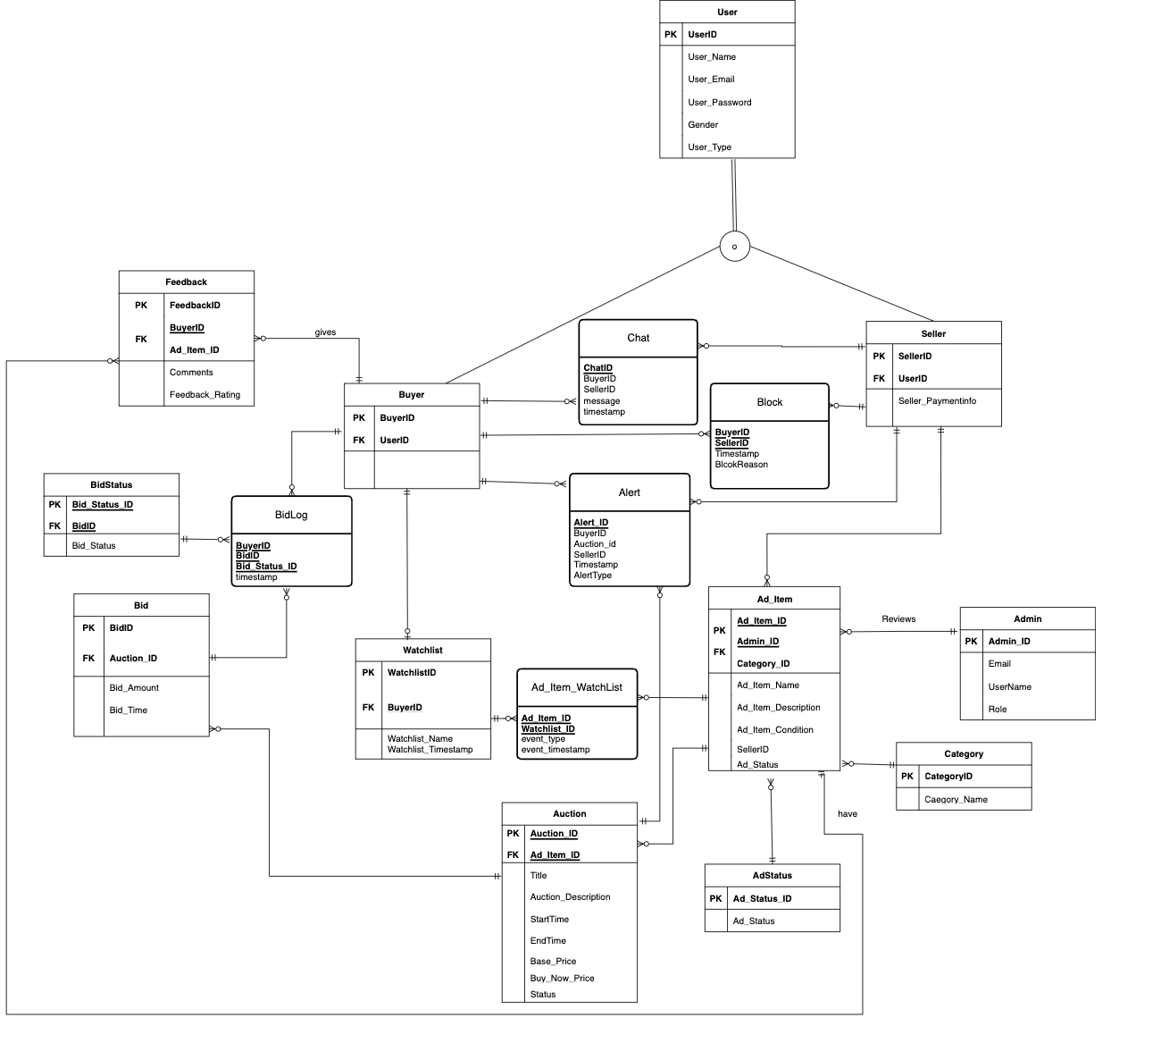
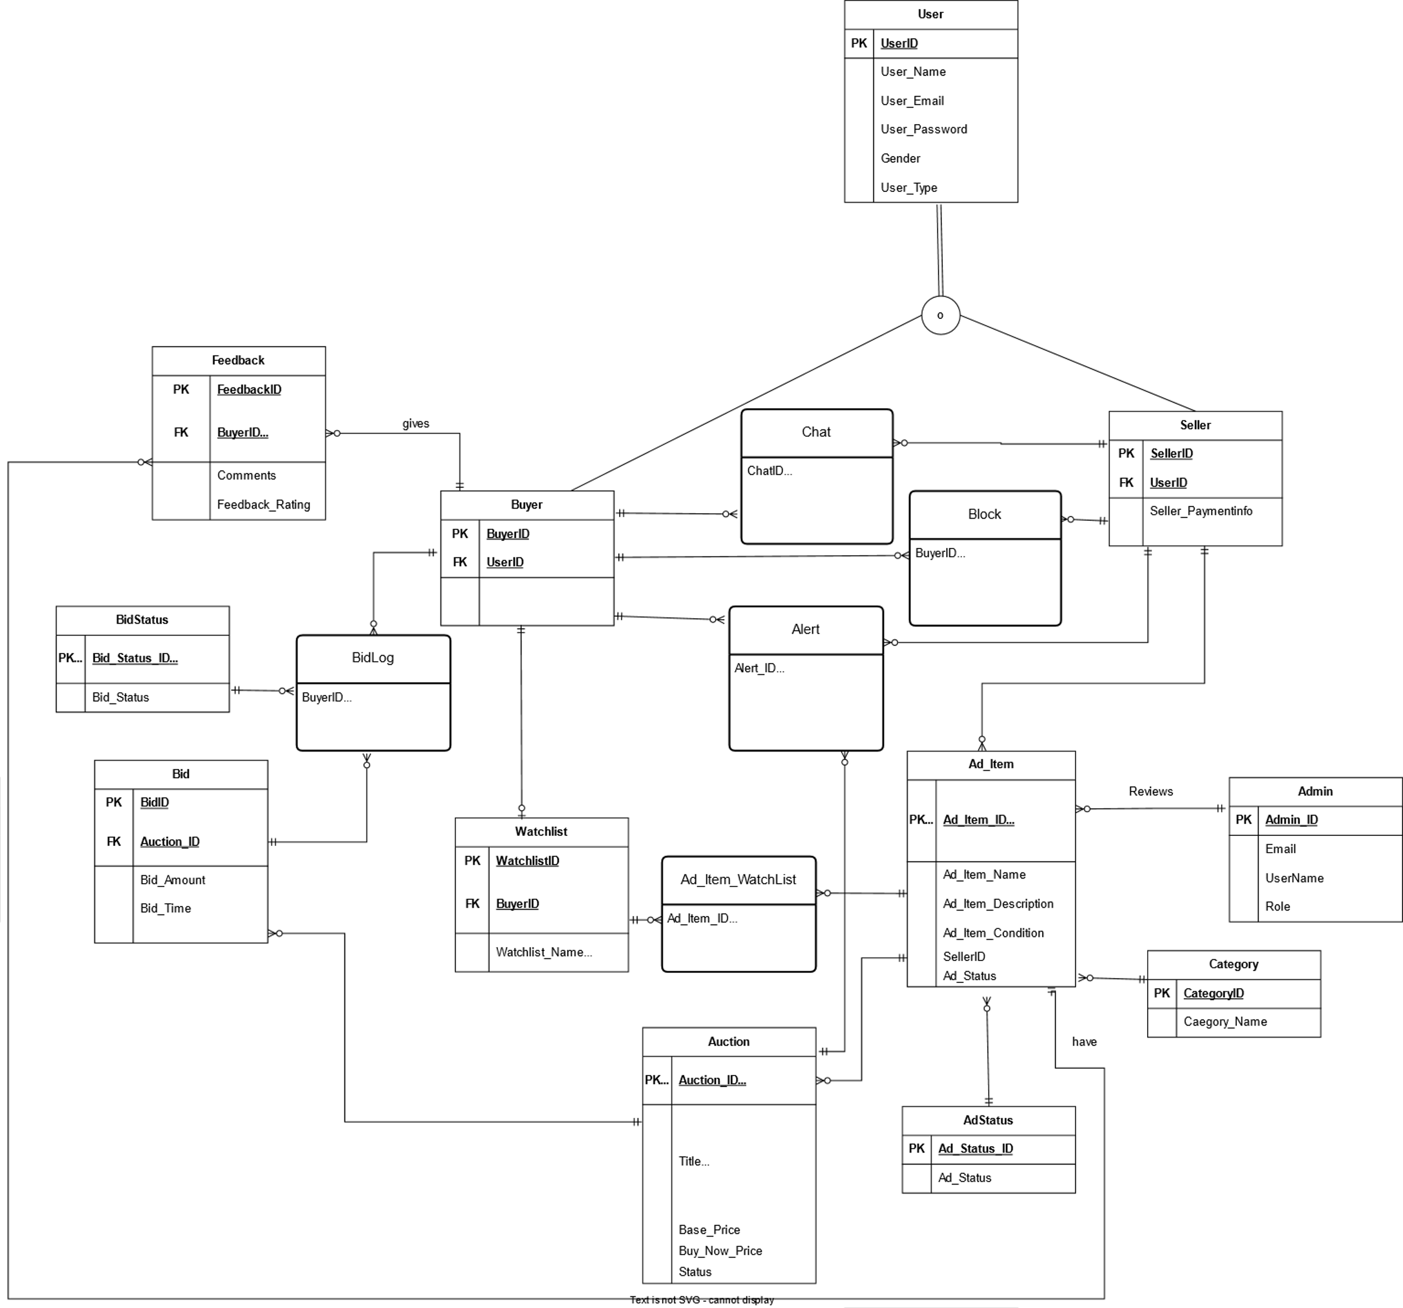
Entity Relationship Diagram

Slide 5
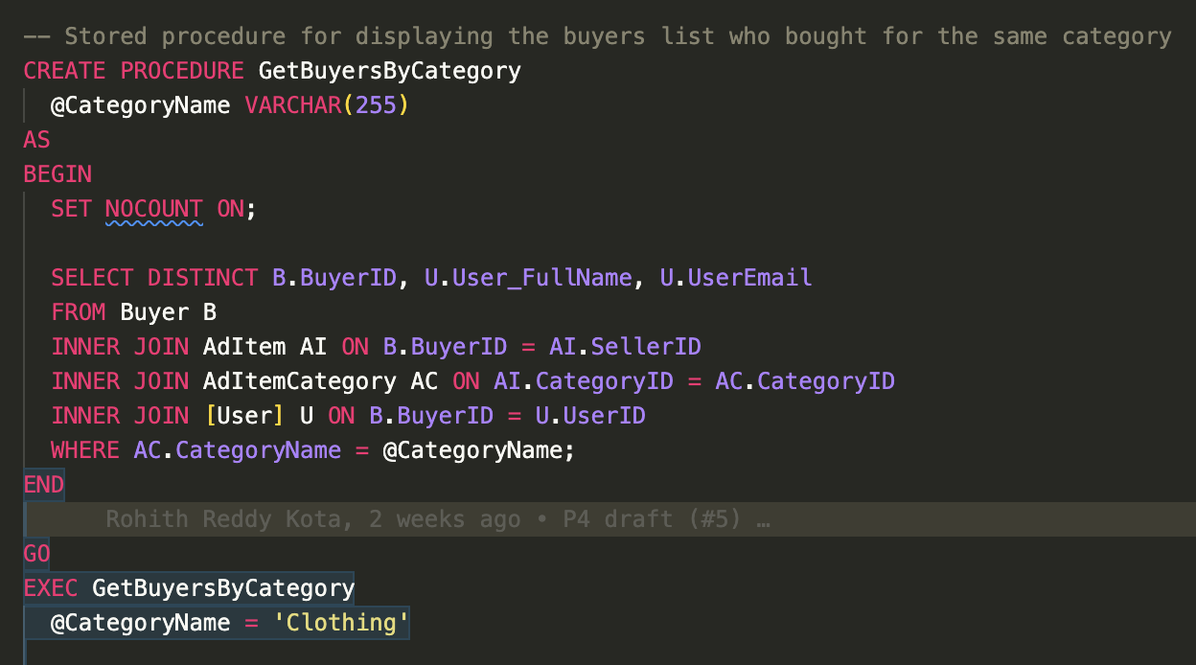
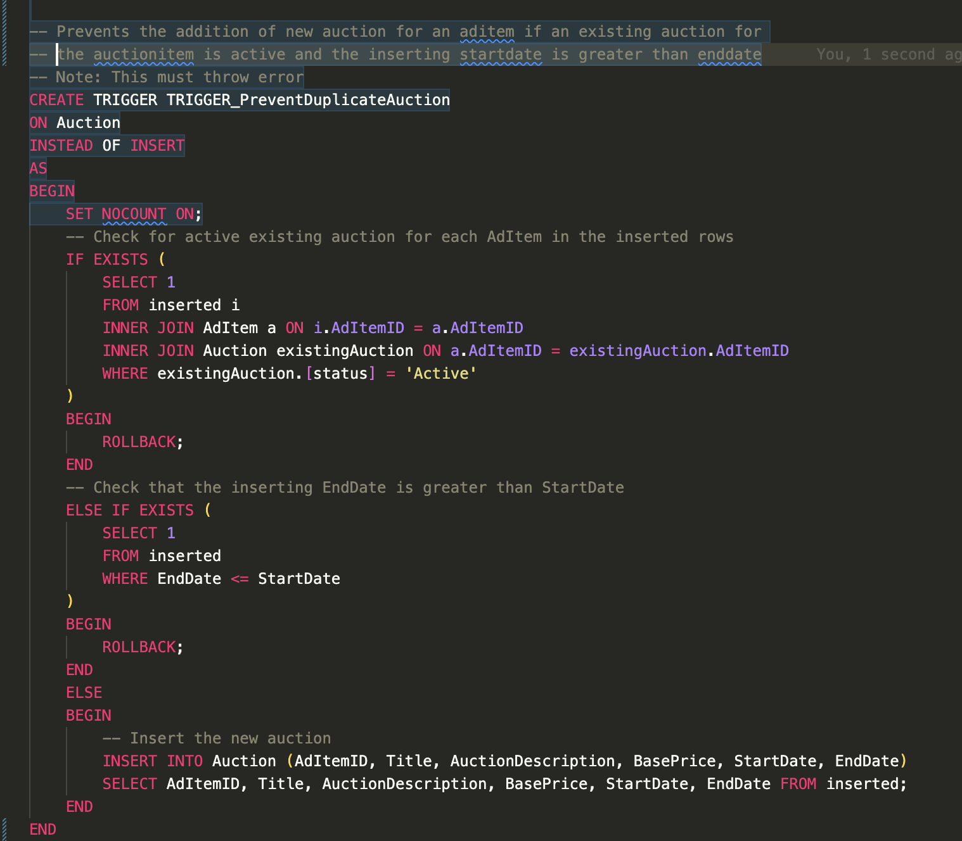
DDL Statements
Stored Procedure
Trigger

Slide 6
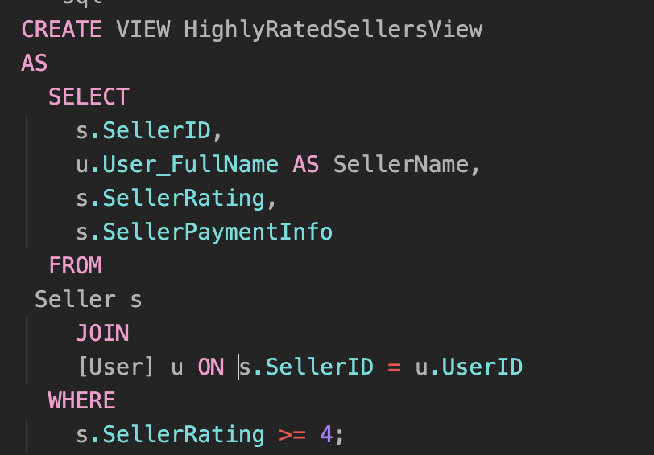
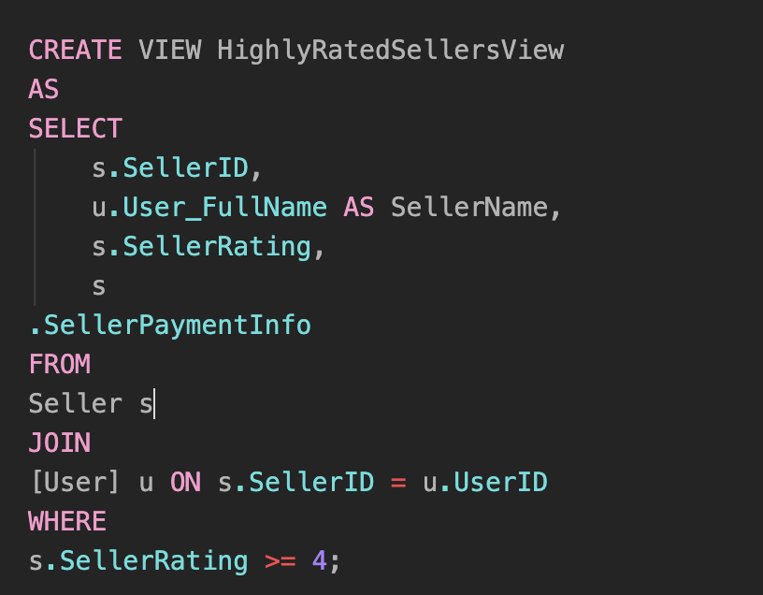
DDL Statements
Views

Slide 7
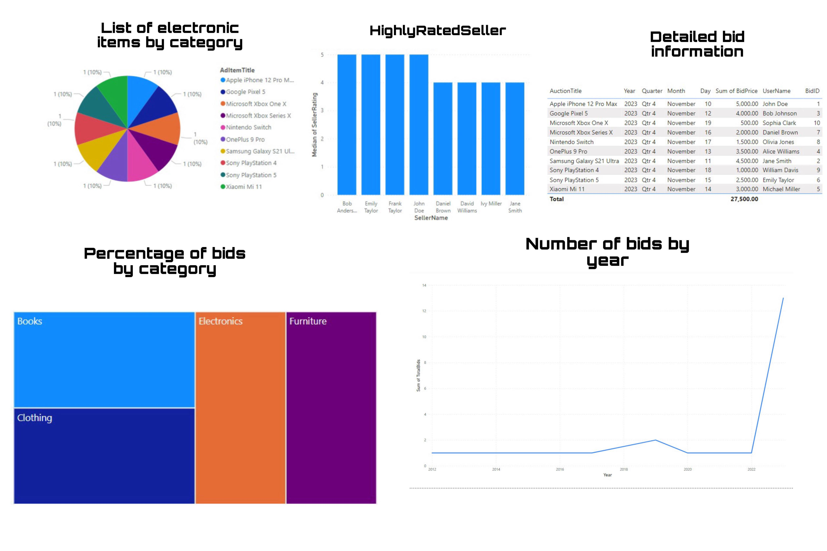
Visualization

Slide 8
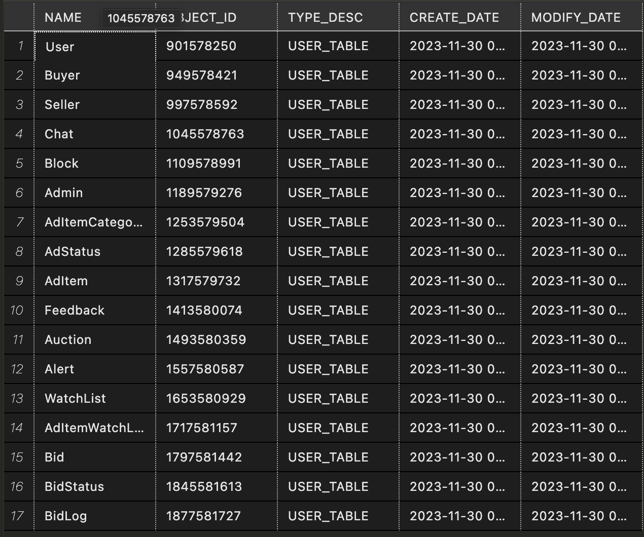
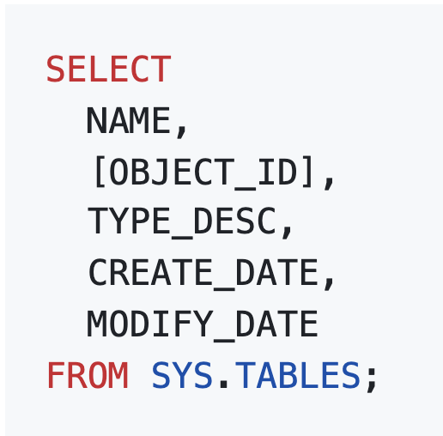
Demo

Slide 9

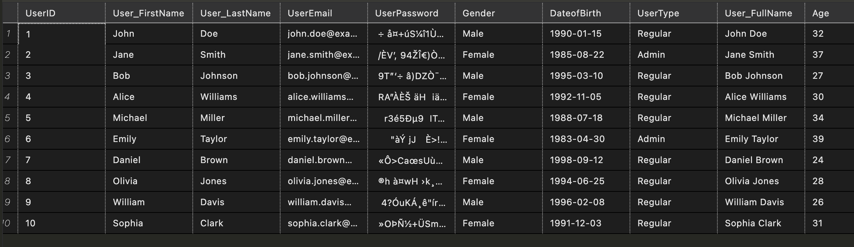
Demo

Slide 10
Learning
Design-First approach is an efficient way to implement the critical system in a smaller number of iterations.
Database design is the driving factor for any application. As database design change becomes difficult over time
Databases in general provides everything that's required to bring the business rules to life
Applications must rely on databases - Instead of reinventing the wheel

